Slide 1

Implementing the Hodgkin Huxley Model
Khulud Nurani
khuludnurani@gmail.com
Stephen Kiilu
AMMI-AIMS Senegal
skiilu@aimsammi.org
Supervisors: Laura and Chris
You guys are awesome!

Slide 2
Outline of our 10-slide presentation
Reviewing the Hodgkin Huxley Model
(Simplifying it so you can explain it to your future grandchildren)
Showing the model implementation
Manipulating the model

Slide 3

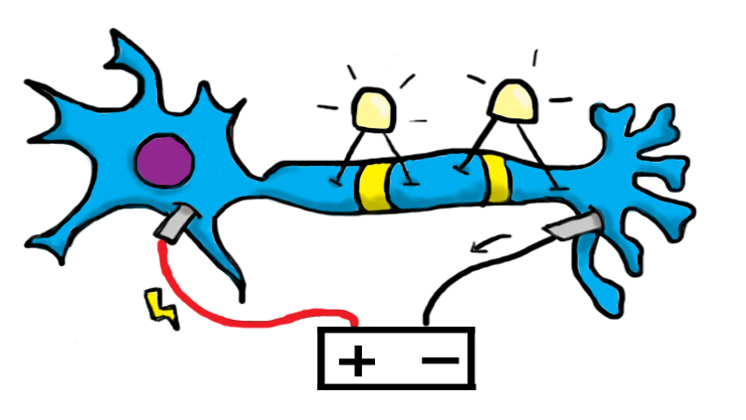
Why implement H-H?
Because it describes how action potentials are initiated & propagated!
Yay!

Slide 4
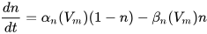
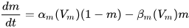
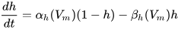
Four equations approximate the electrical characteristics of a neuron
capacitance
K current
Na current
leaky current
rate of change of n (probability of K channel being open)
rate of change of m (probability of Na activation channel being active (open channel))
rate of change of h (probability of Na inactivation channel being inactive (open channel))
Notes:
I = current
C_{m} = capacitance
g_{K}, g_{Na} , g_{l} = conductances
V_{K}, V_{Na}, V_{l} = reversal potentials
𝞪, 𝜷 = opening and closing rates for ion channel
n = probability of K channel activation
m = p(Na channel subunit activation)
h = p(Na channel subunit inactivation)

Slide 5

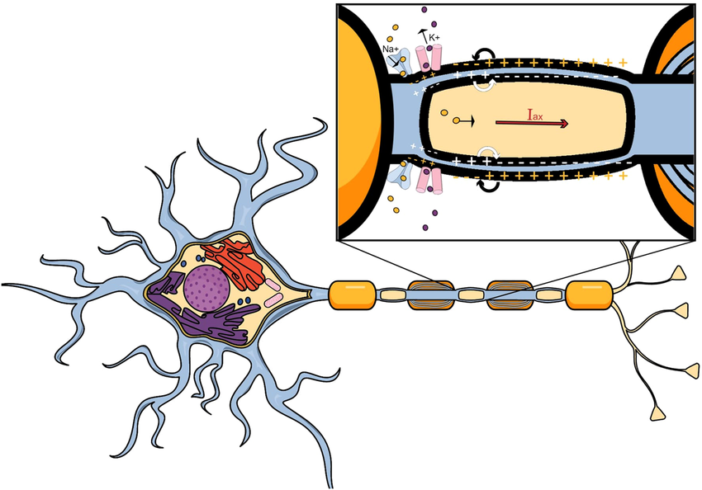
Once more: the H-H Model describes how action potentials are initiated & propagated using four equations

Slide 6
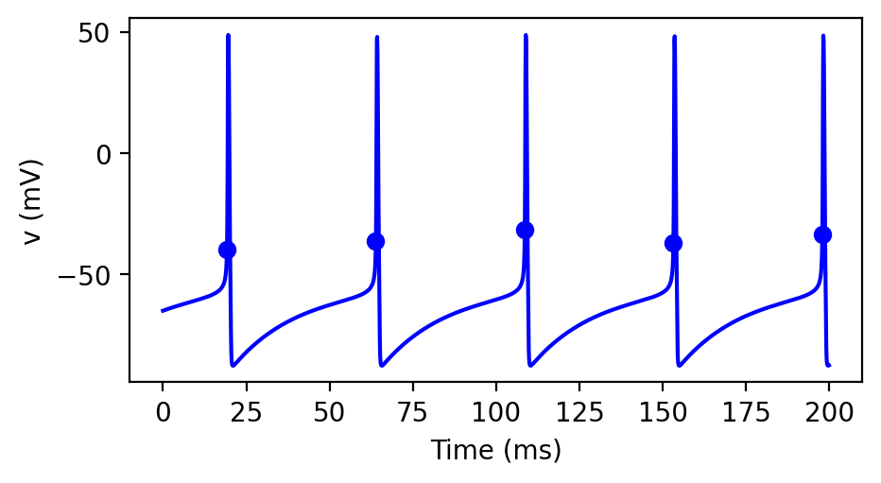
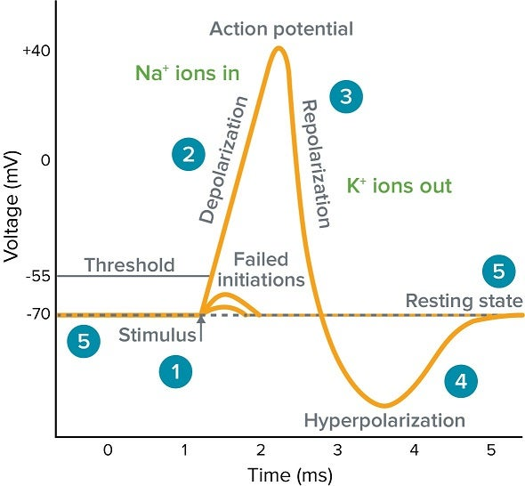
H-H spiking neuron showing beautiful action potentials & the 5 phases of each

Slide 7
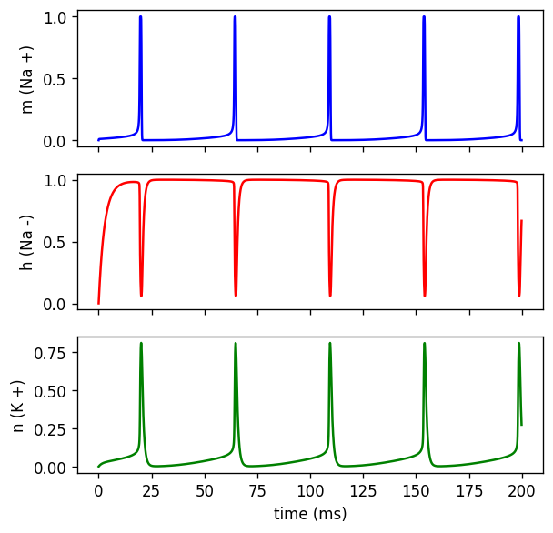
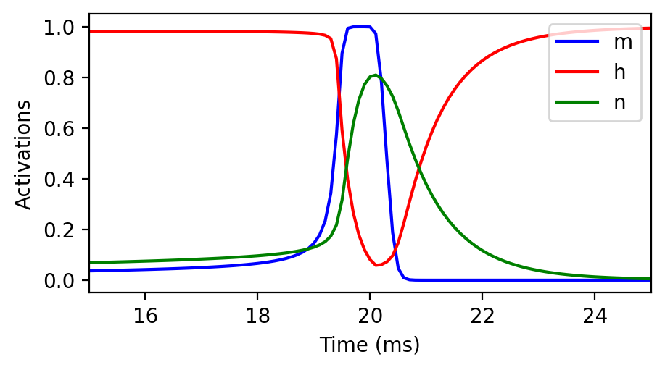
n, m active & h inactive during action potentials
A
B
Combined & zoomed in
m= Na activation
h= Na inactivation
n= K activation
n,m,h against time

Slide 8
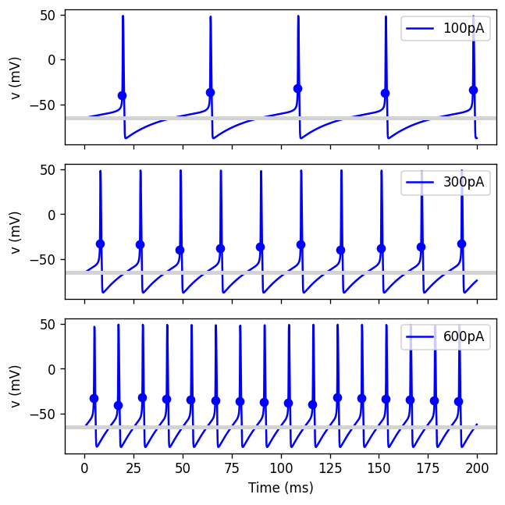
Lets manipulate the model now :)
Increasing the input current increases the spiking

Slide 9
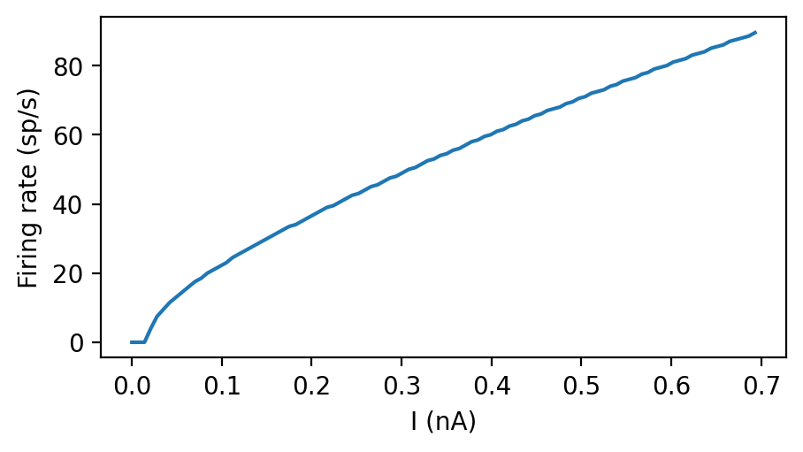
The firing frequency increases with an increasing current

Slide 10
Conclusion
Understand the propagation of action potential
Formulated HH model mathematically
Implemented the HH Model in Brian 2
Introduced the gating variables to model opening of ion channels

Slide 11


Thank you!

